Slide 1
Eco-Friendly Stationery Items
Presented By:
Amrita Sutar 210543181007
Bhushan Chaudhari 210543181015
Rohan Patil 210543181063
Shubham Patil 210543181065
Guided By:
Mrs.Harshita

Slide 2
Objective
The project is a web-based e-commerce application where users can get all the eco-friendly stationery products. The system automates the conventional process of buying products from local market, rather by visiting the place. User can get all these products at their door steps.

Slide 3
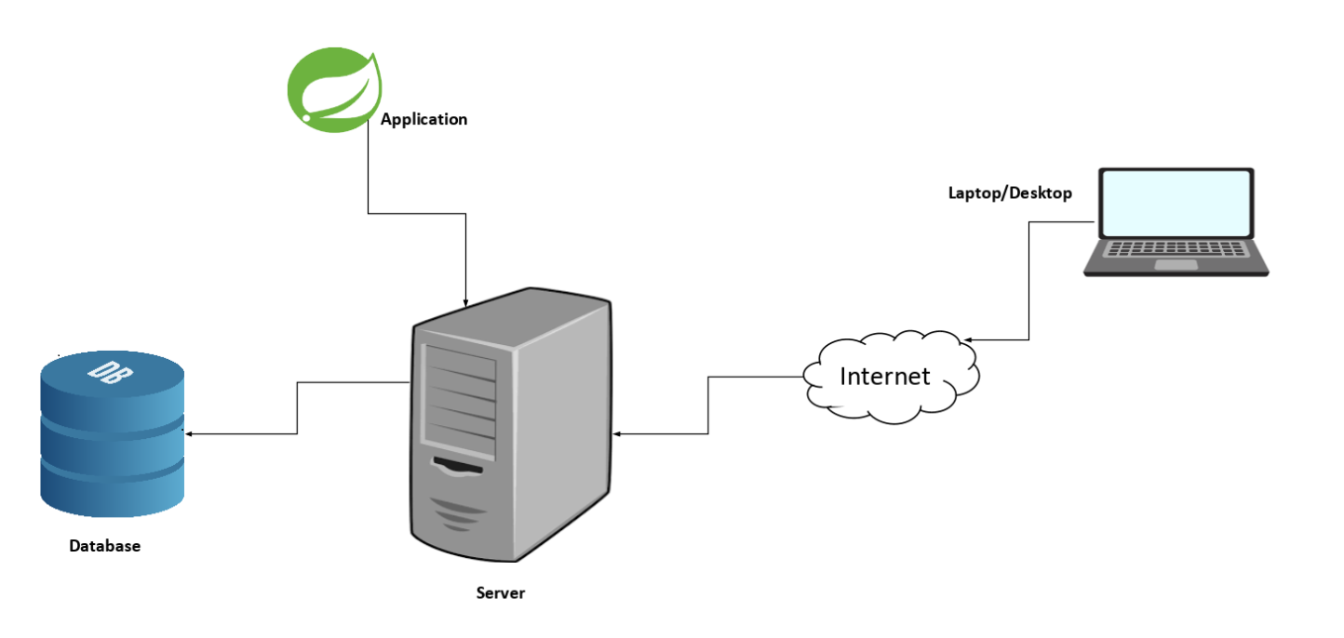
Architecture Diagram

Slide 4
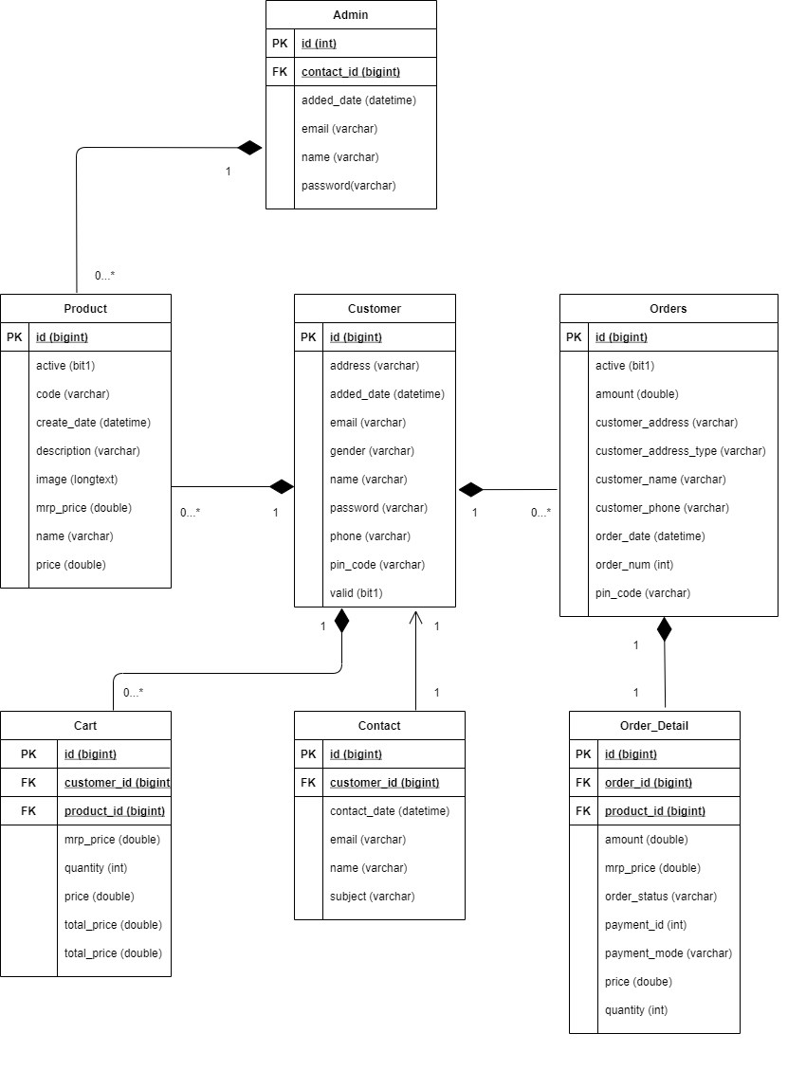
Class Diagram

Slide 5
Modules
User Module:
1. Display the User Home page where consumer can see first 8 products and all available products in All Products tab.
2. View information about store and can contact to Admin.
3. Can update User account, change password.
4. Consumer can view products added in cart, buy products and view all orders history and can cancel orders at any time before order gets delivered.

Slide 6
Modules
Admin Module:
1. Display the Admin Home page where admin can see top 10 pending orders and can change status of orders to delivered, cancel orders.
2. Admin can add products, view products and change the status of product to
Active-Inactive.
3. View number of consumers and can delete them.
4. View list of users who contacted.
5. Can update Admin account, change password.
6. Can see delivery, payment report by searching particular order Id in all orders.

Slide 7
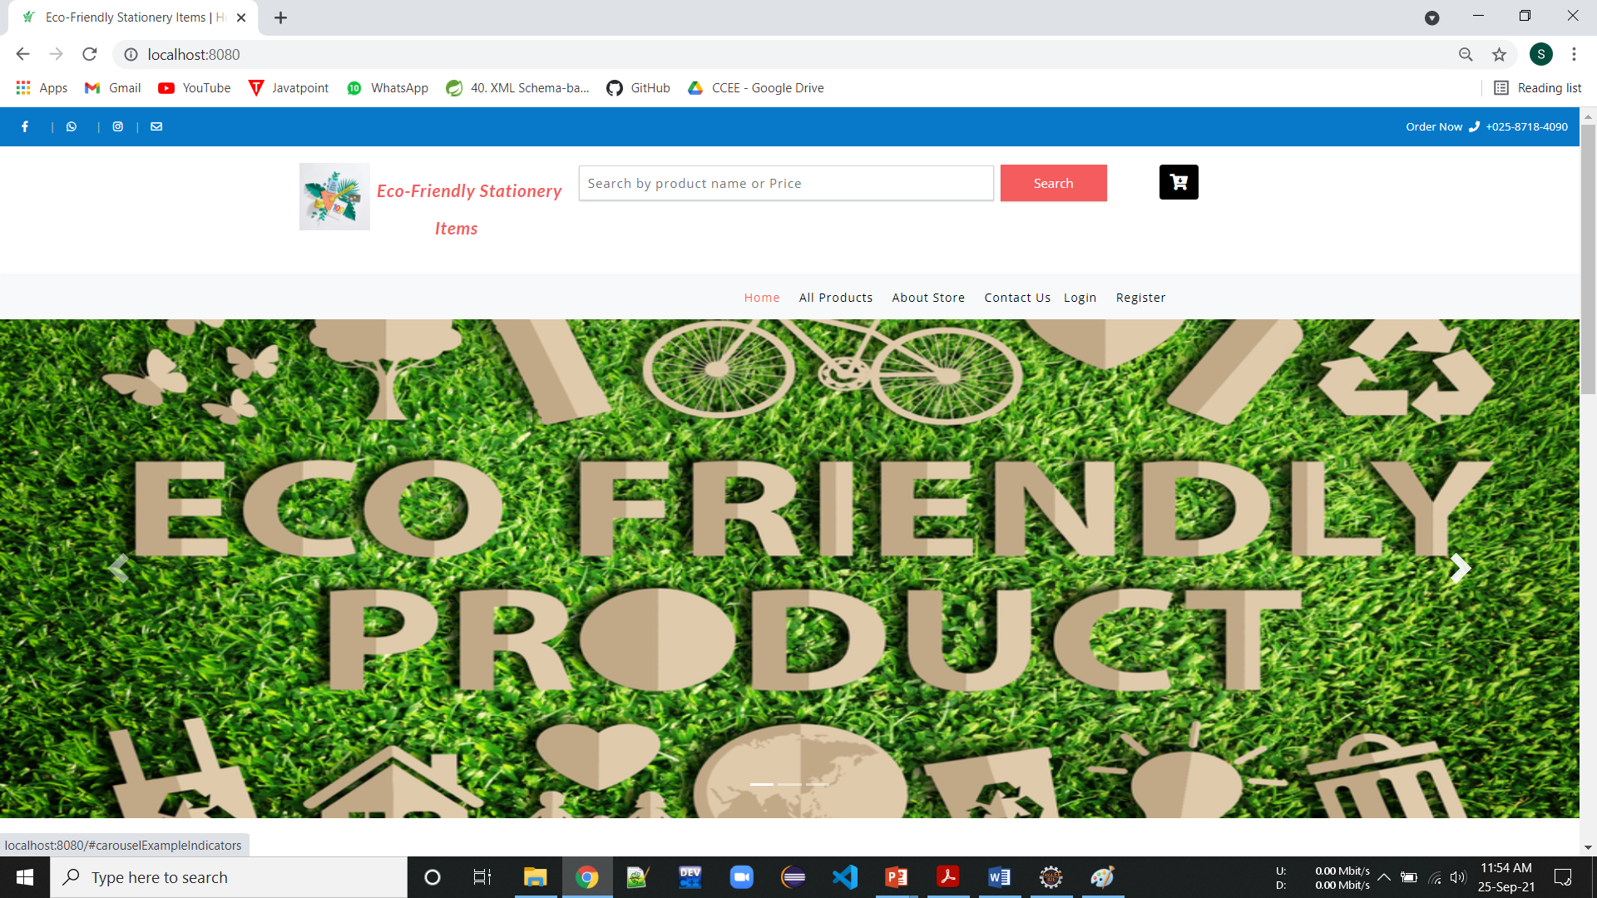
Interface: Index Page

Slide 8
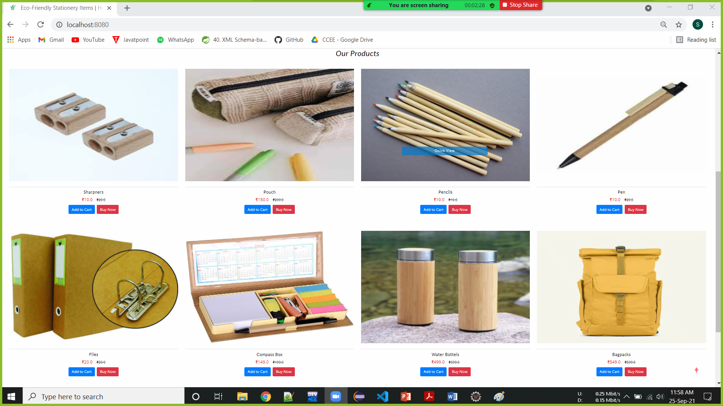
Product View

Slide 9
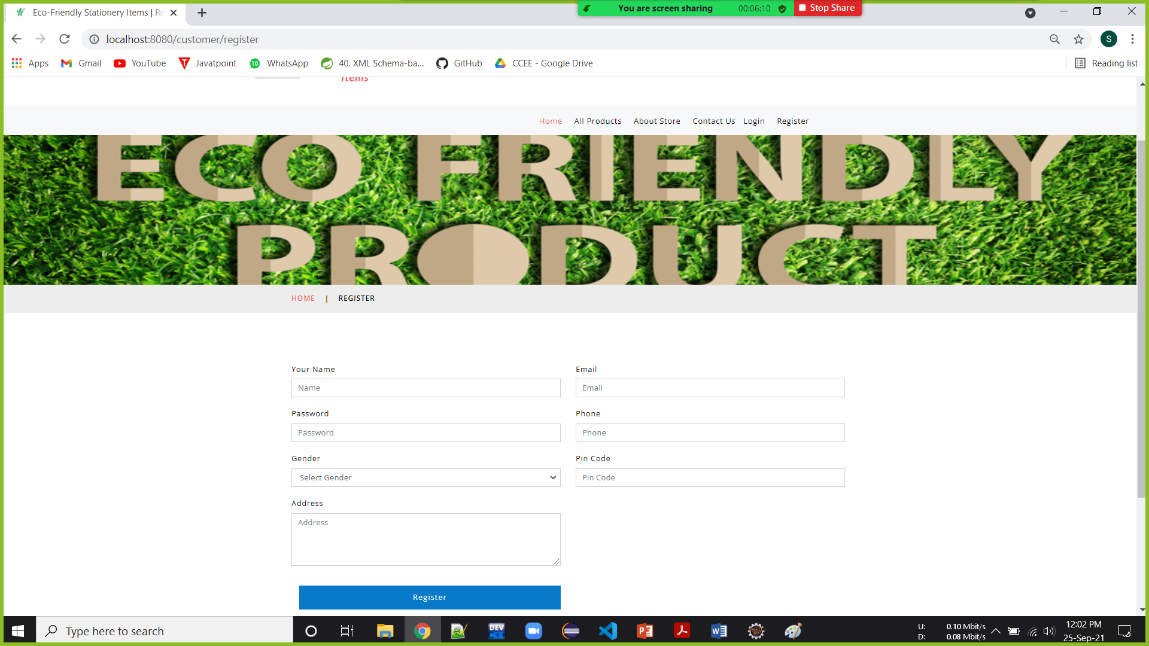
Register Page

Slide 10
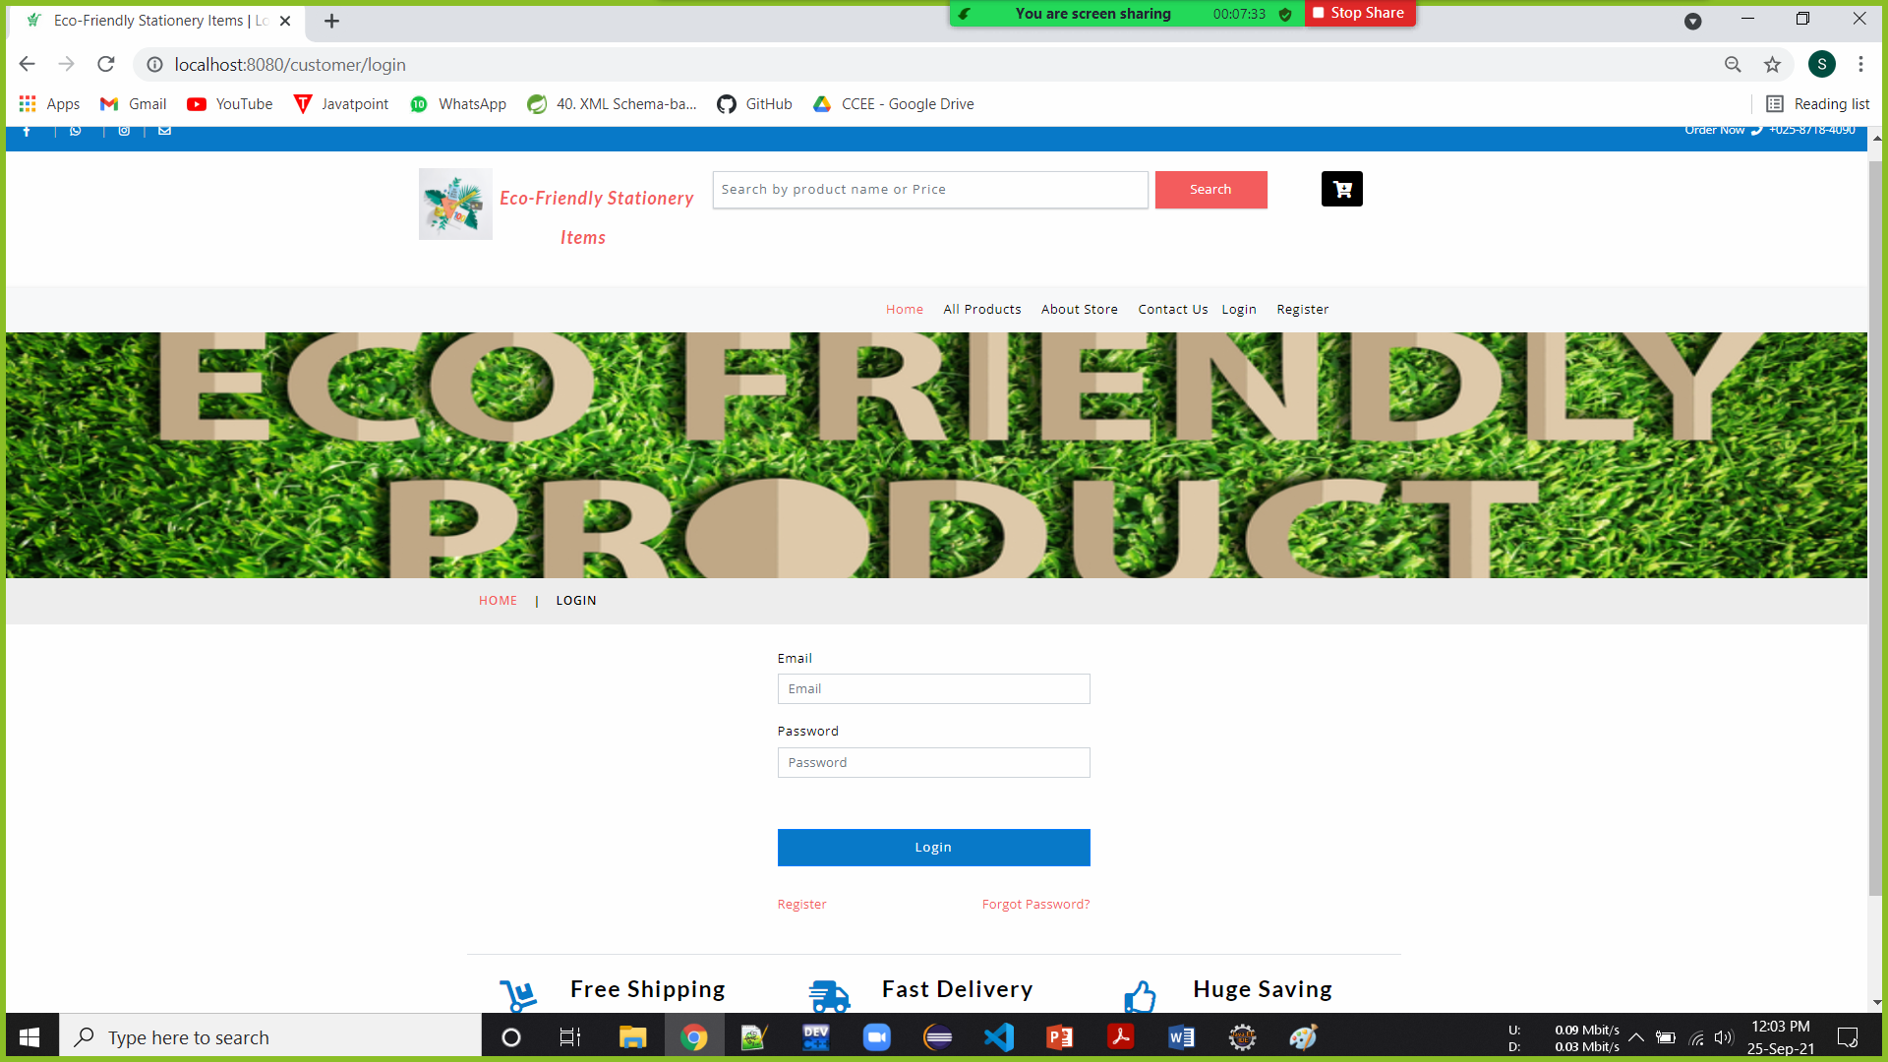
Admin/User Login Page

Slide 11
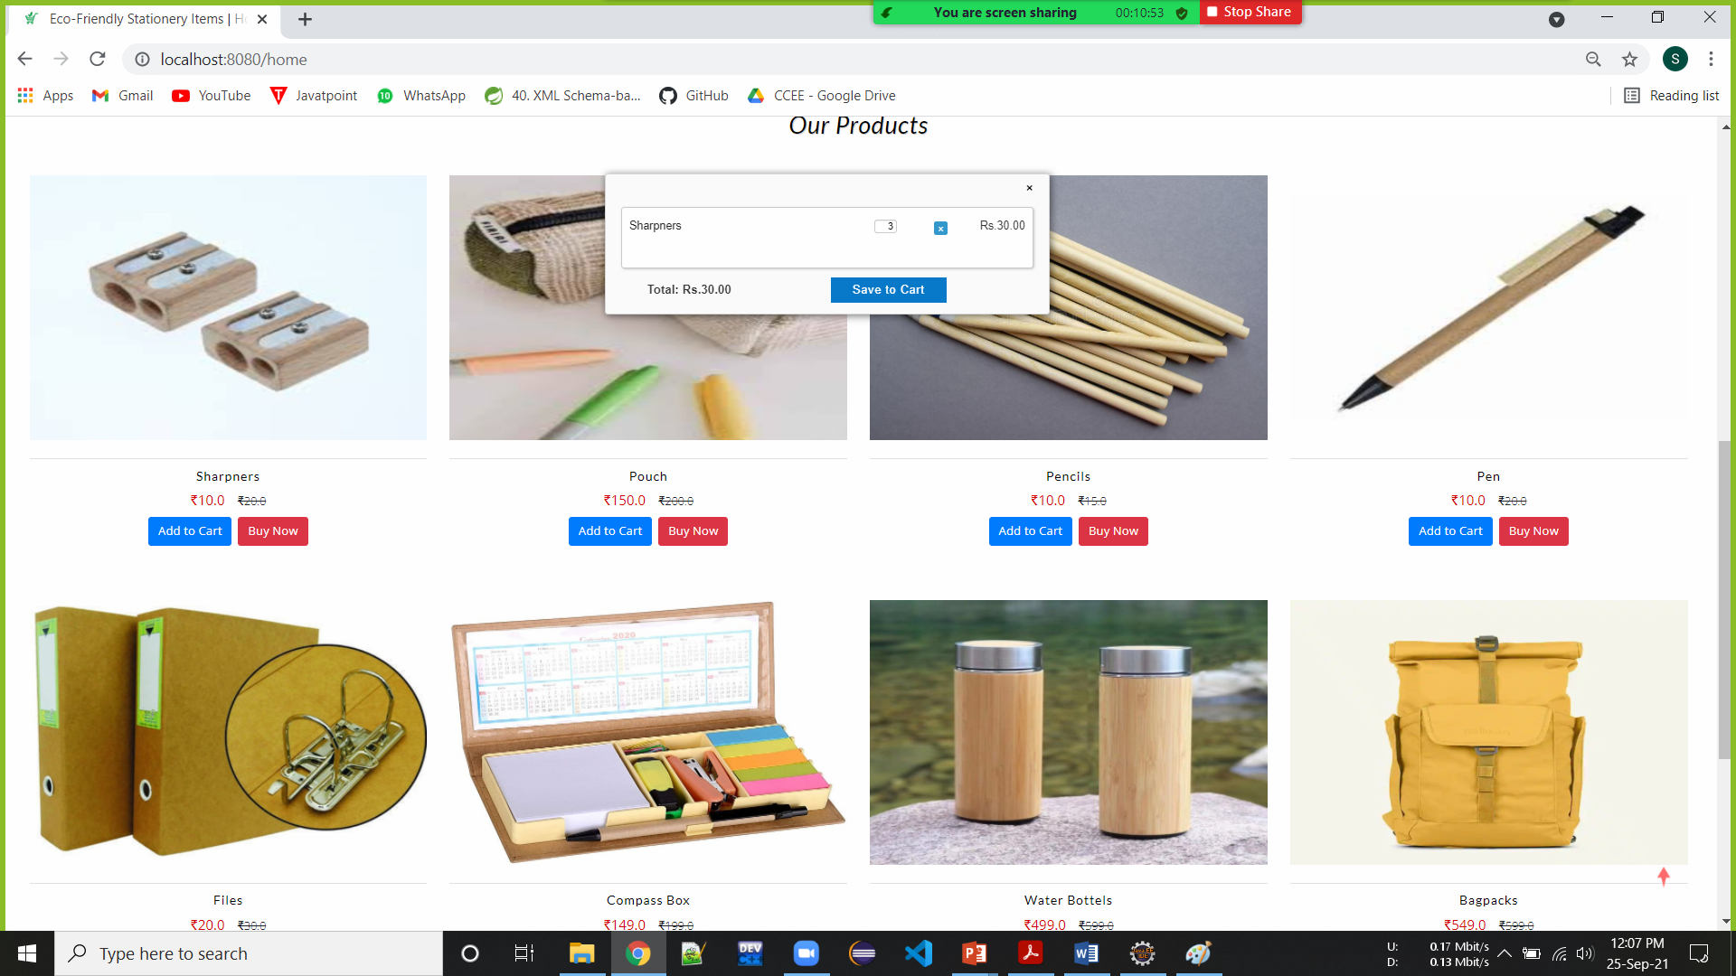
Add to Cart

Slide 12
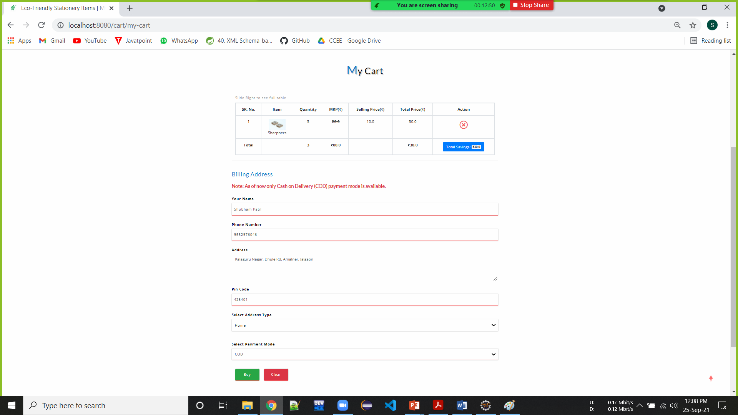
My Cart

Slide 13
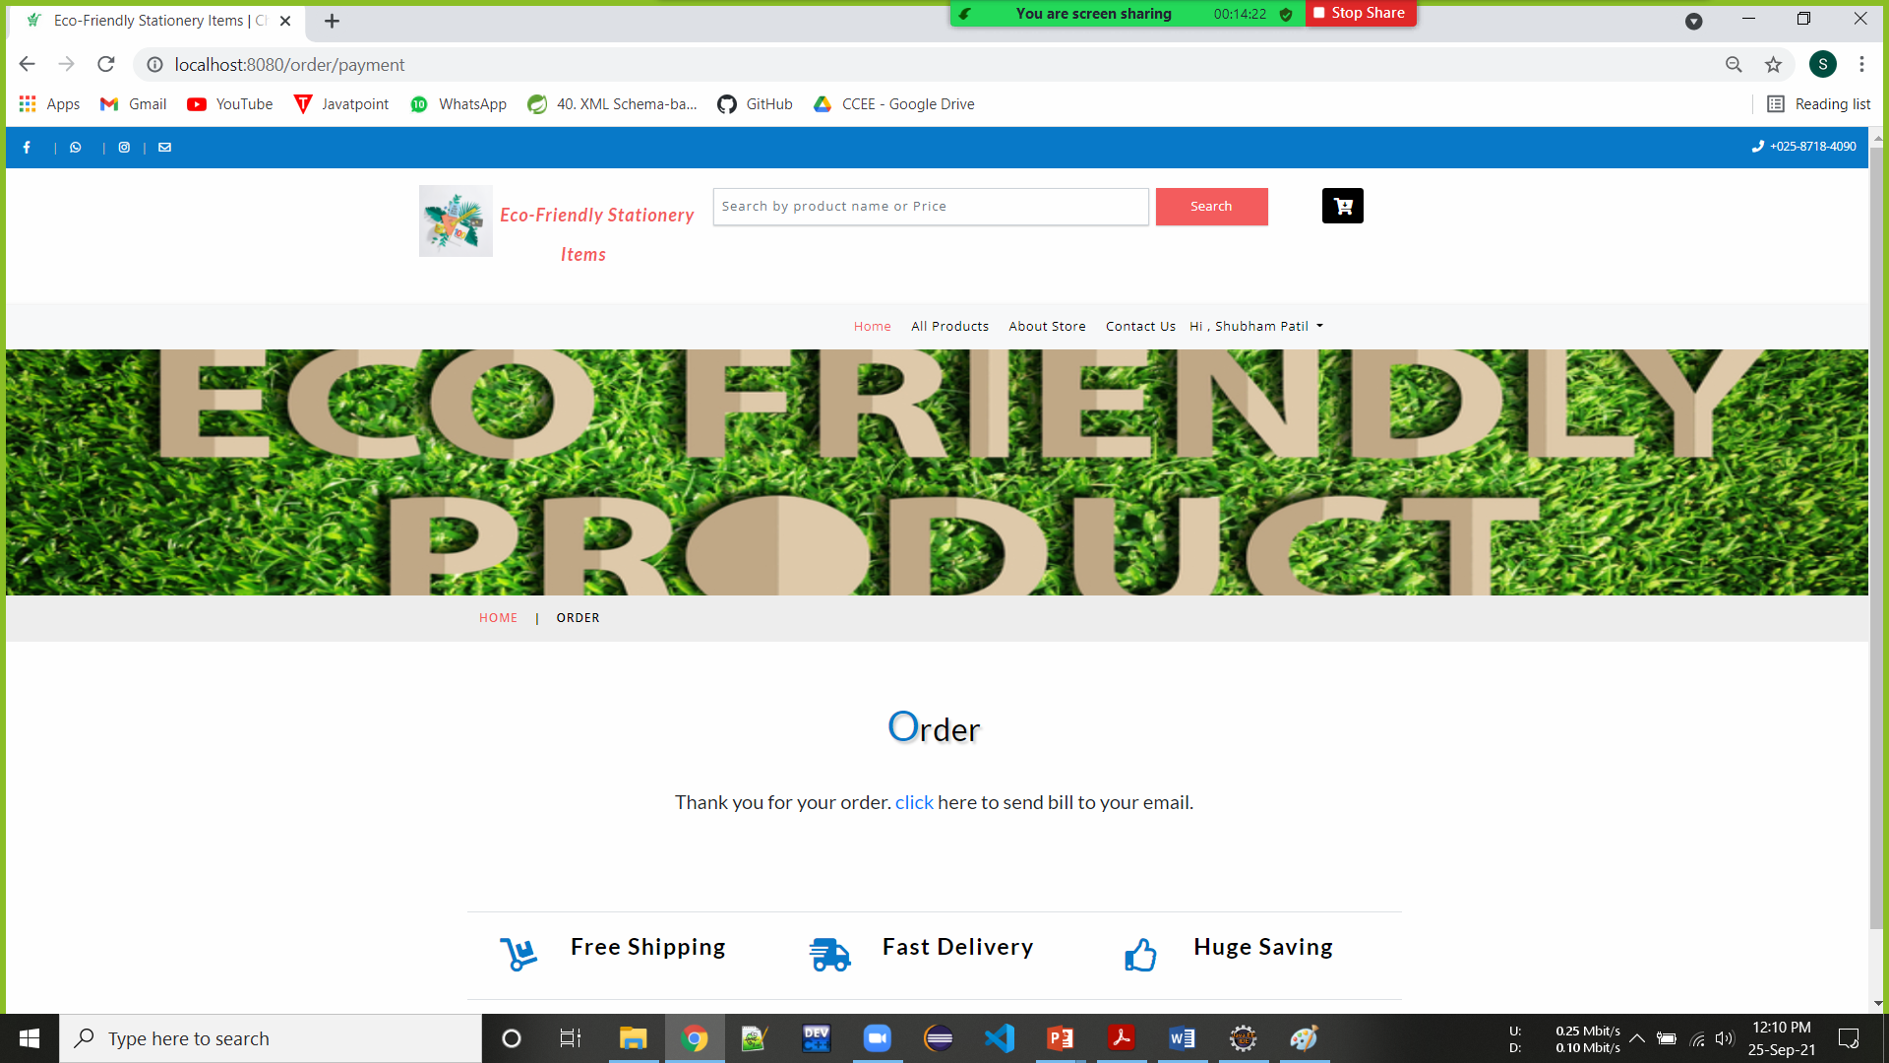
Order Success

Slide 14
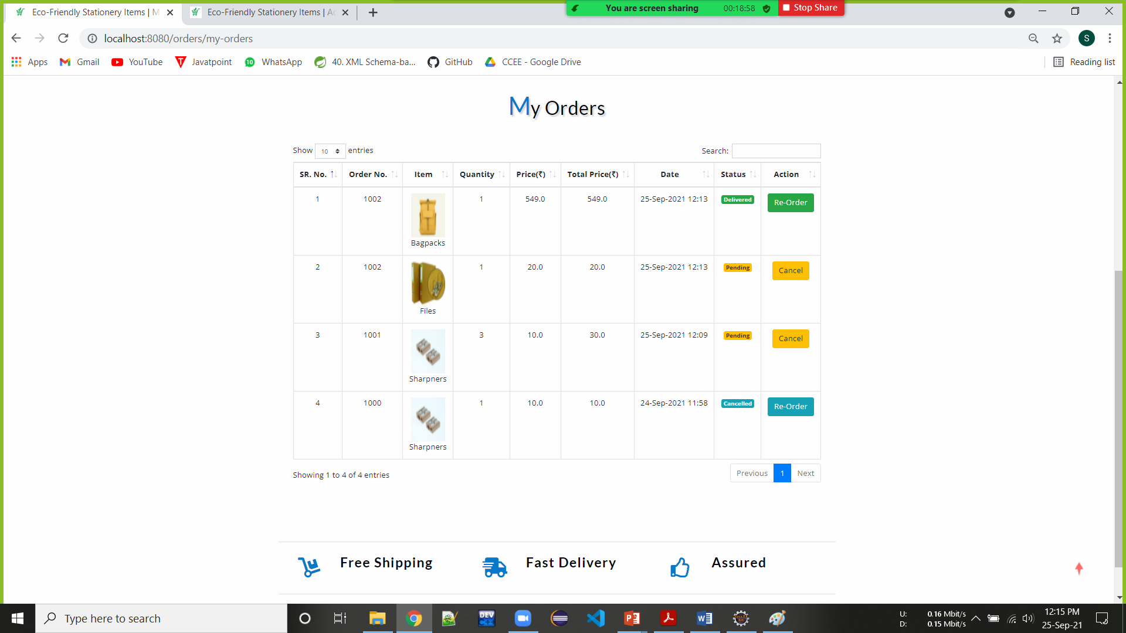
User Orders

Slide 15
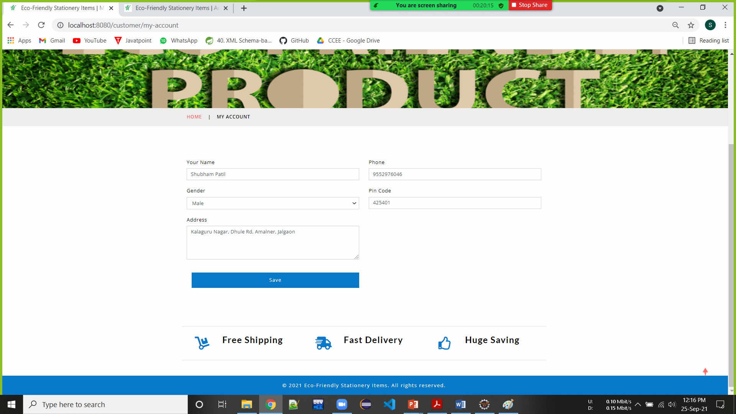
User Account

Slide 16
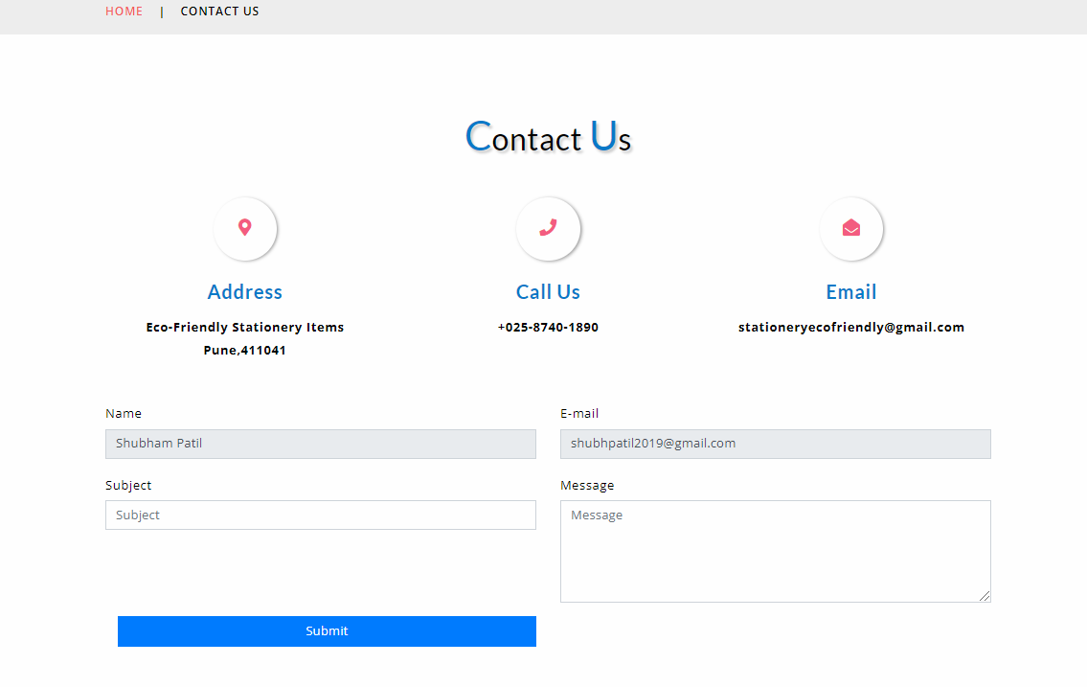
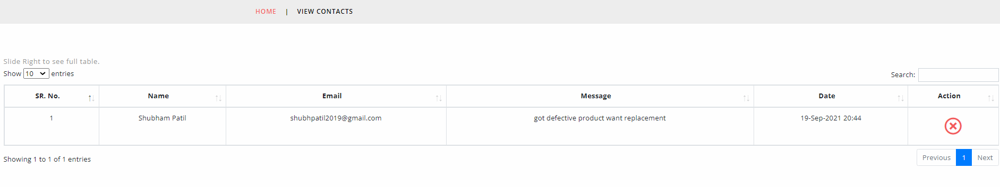
Contact Admin
Customer Contact

Slide 17
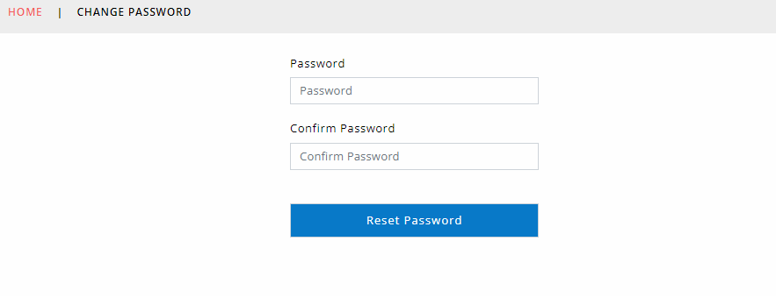
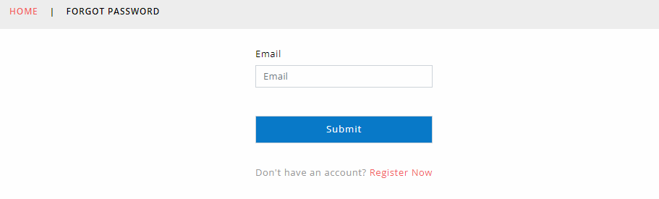
Admin/User Reset/Forgot Passwords

Slide 18
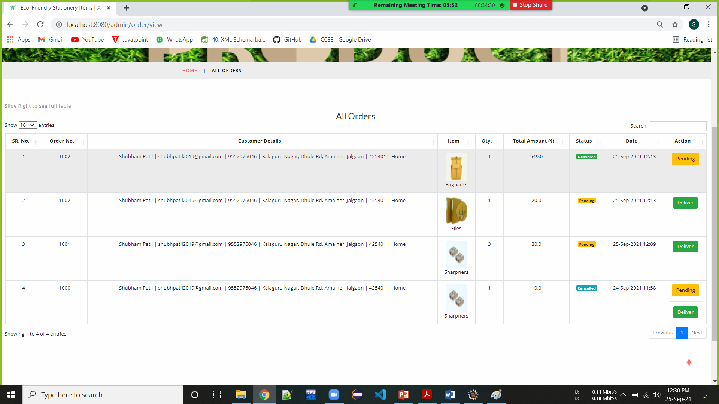
All Orders

Slide 19
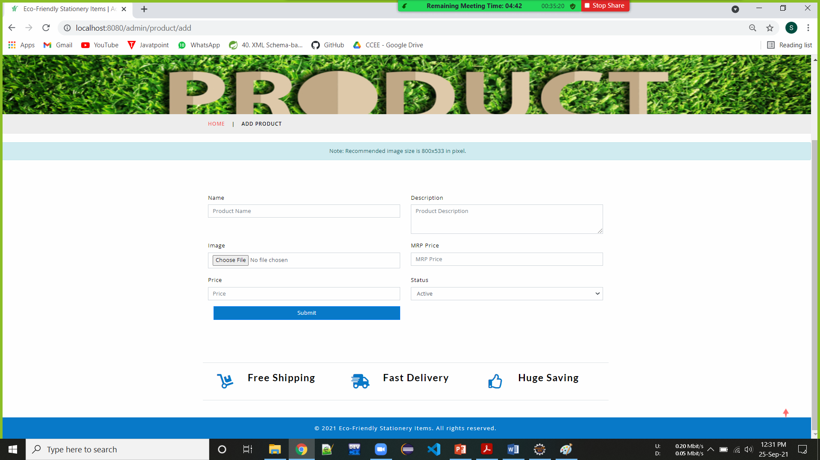
Add Product

Slide 20
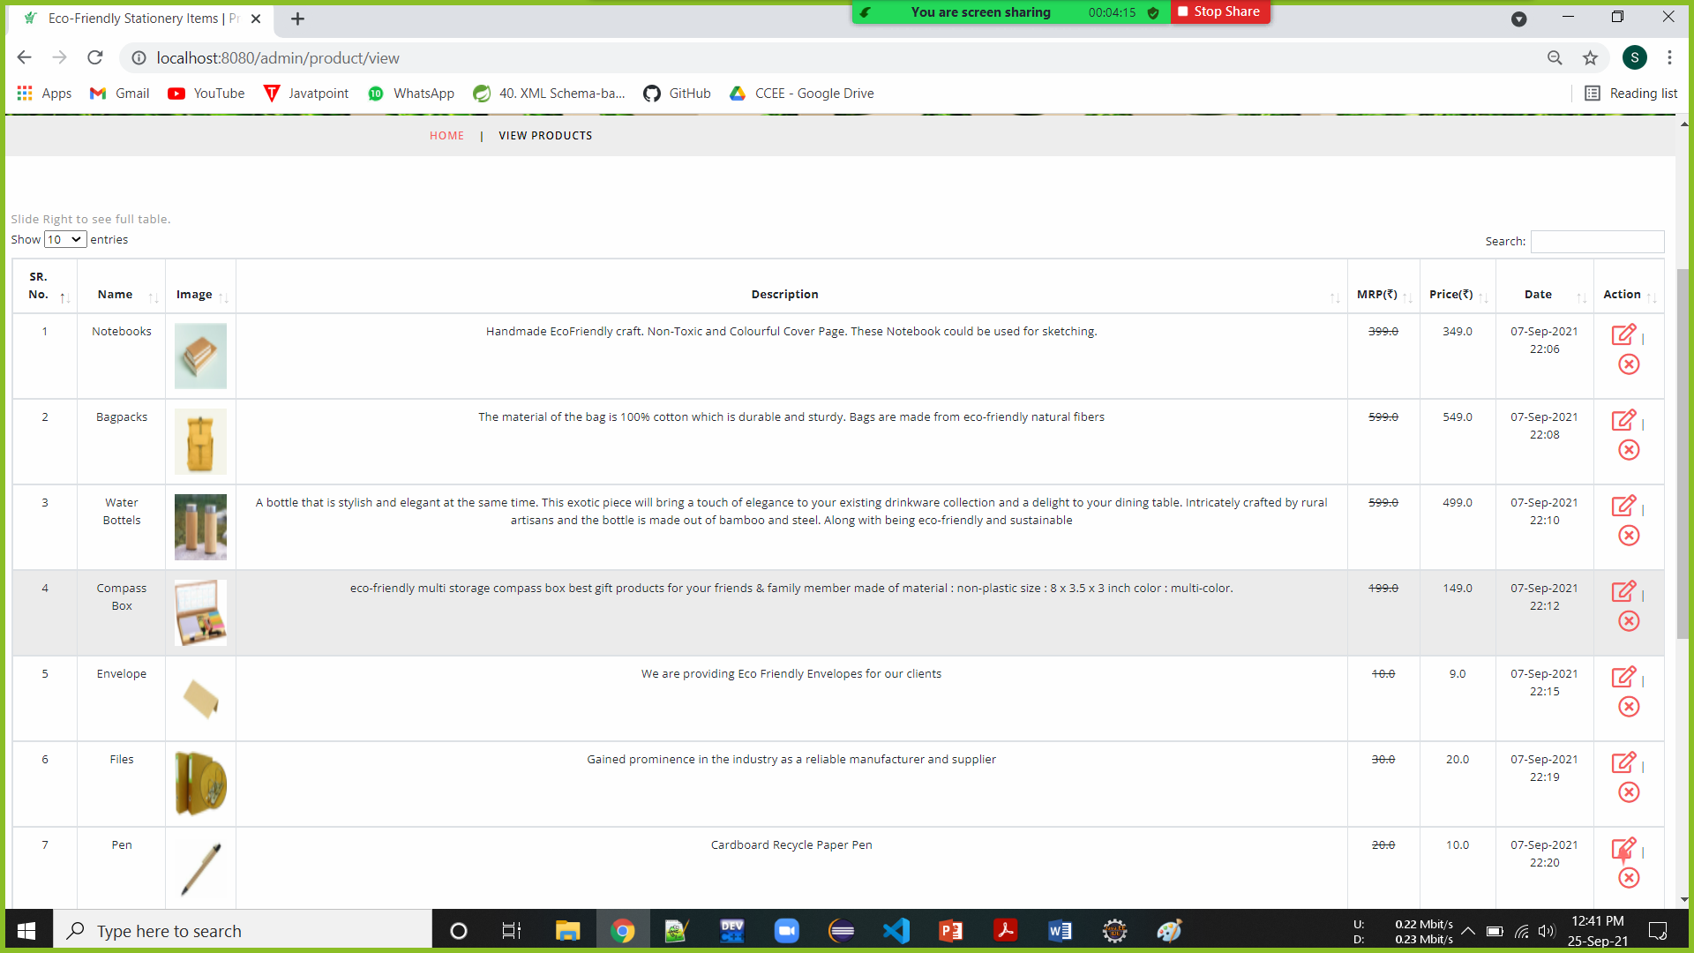
View Products

Slide 21
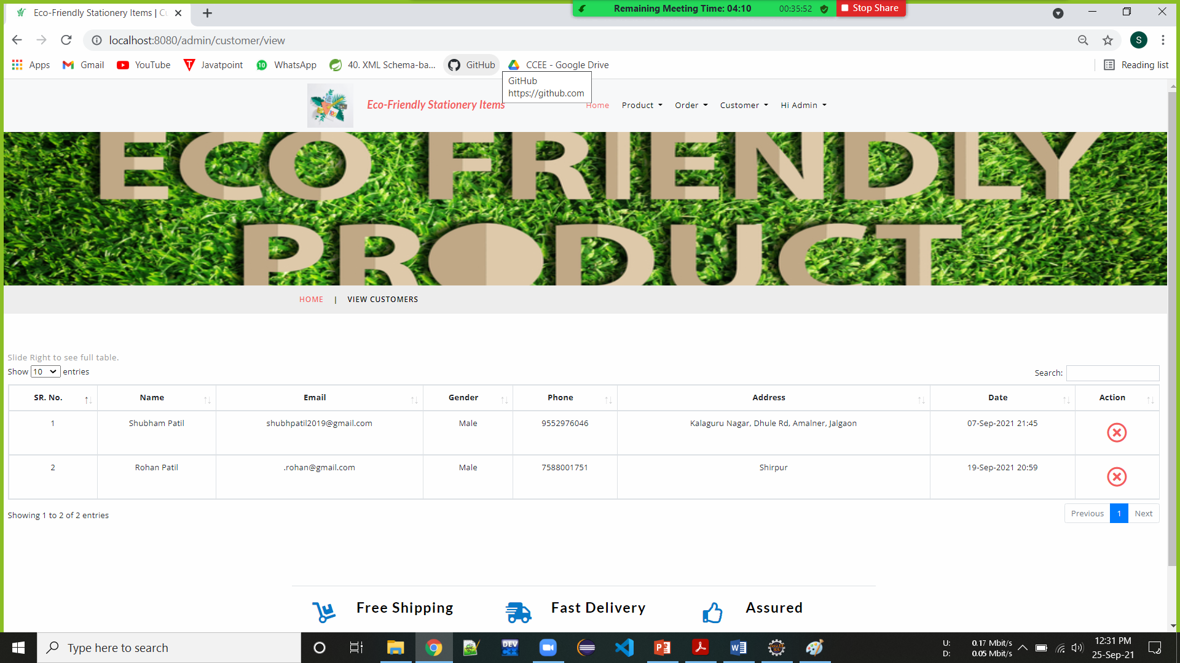
View Users

Slide 22
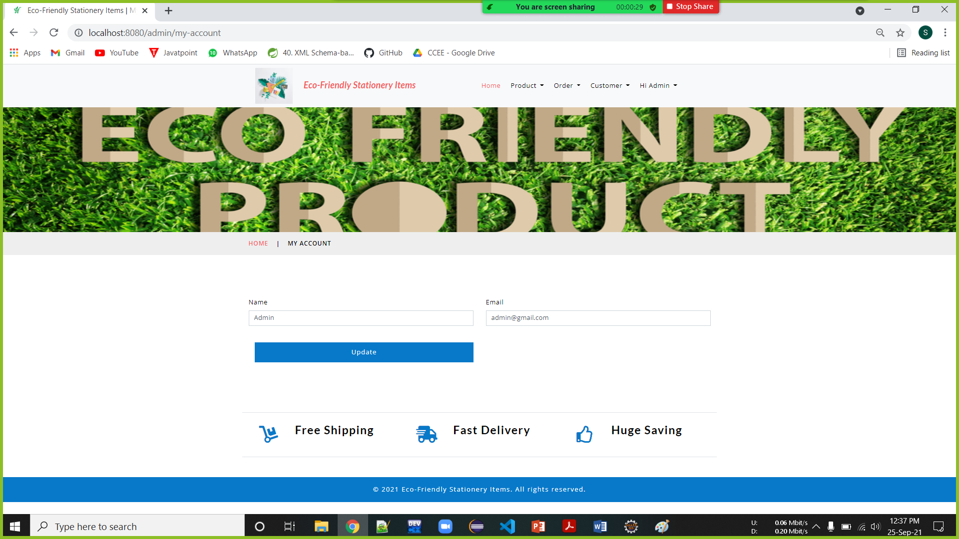
Admin Account

Slide 23
Future Scope
The scope of the proposed system is to provide best possible web application for user to buy these available eco-friendly stationery items.
In future we will try to provide or available daily needed eco-friendly products for users.
The objective behind this system is to invent a system widely acceptable for buying eco-friendly products which are rarely known to users or easily not available.
We are recommending, bring awareness among people to use these environment friendly products through Social Media Marketing.

Slide 24
Conclusion
This software has large variety of handpicked eco-friendly stationery items. The User Interface of it is very friendly and can be easily used by anyone. It also decreases the amount of time to find this rarely available stationery items and user can buy this items at their door steps. Thus, it saves human efforts and resources.

Slide 25
Thank You!

